Slide 1
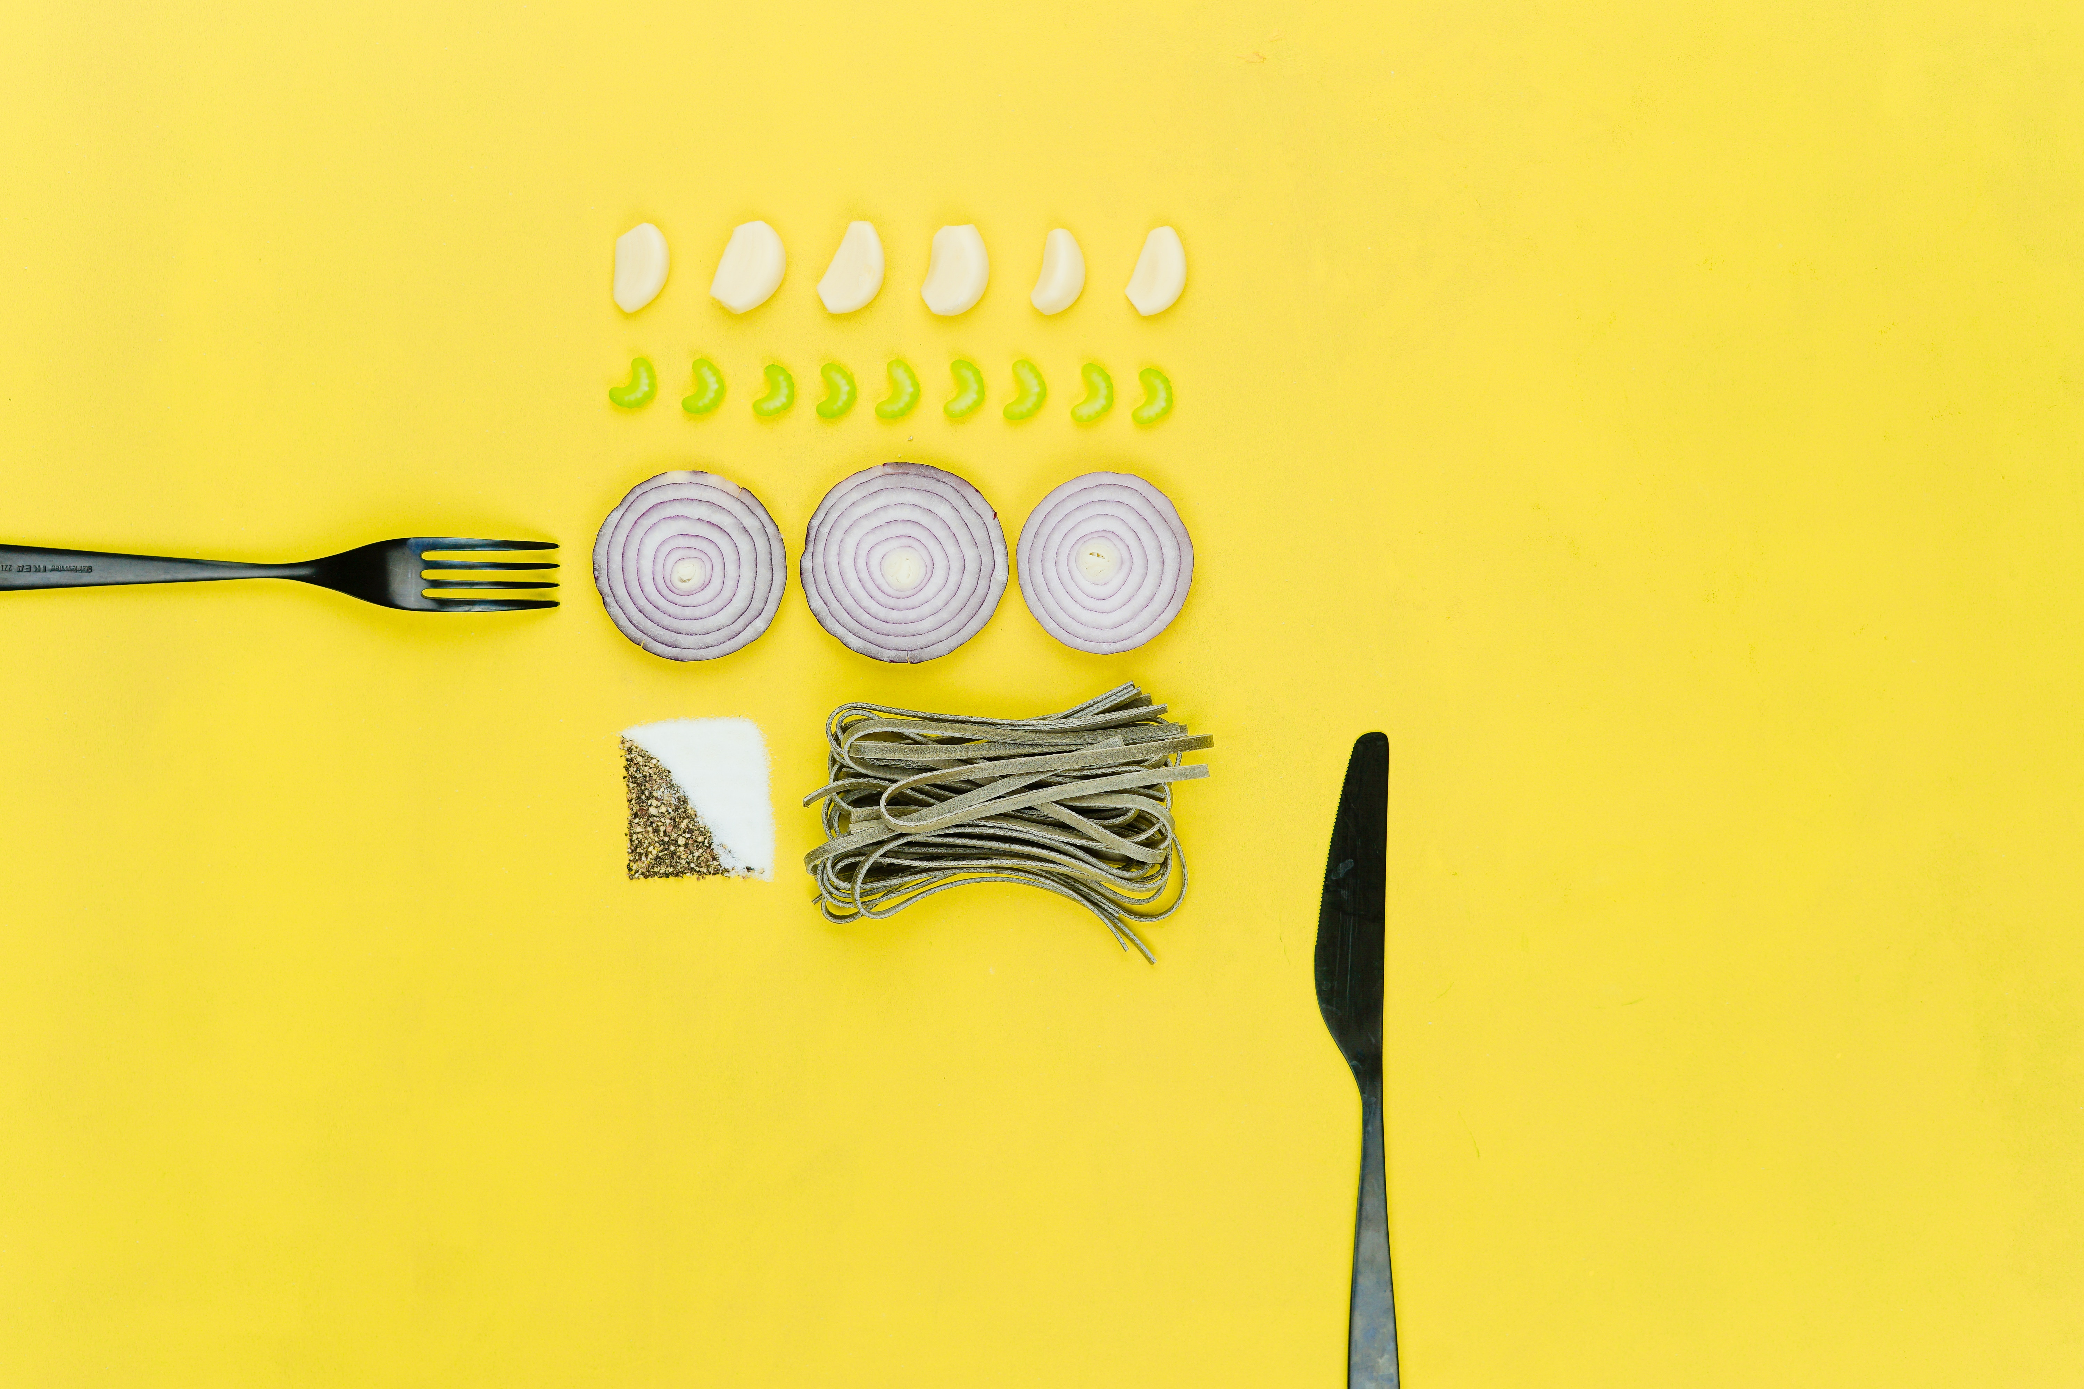
What’s for Dinner Today?
Anna Ayzenshtat
Muriel Grobler
Sarah Colby

Slide 2
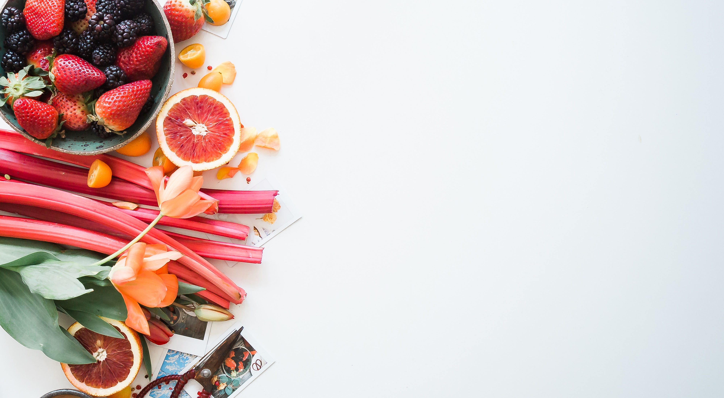
How We Built It
20k recipes
gensim word2vec model
user input
word_vec
recipes

Slide 3
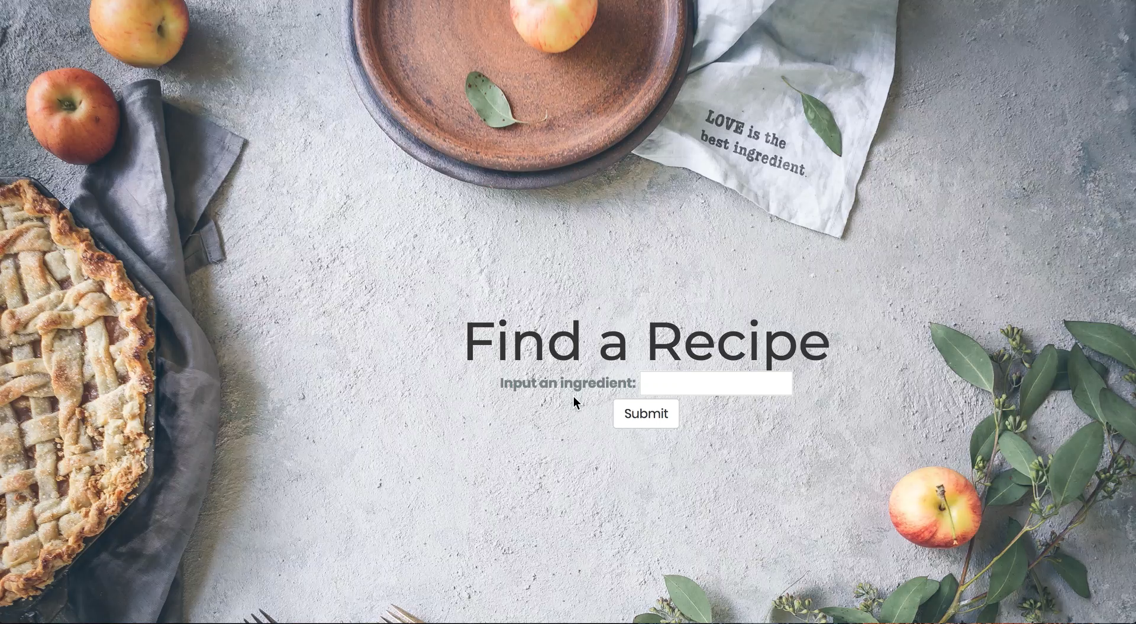

Slide 4
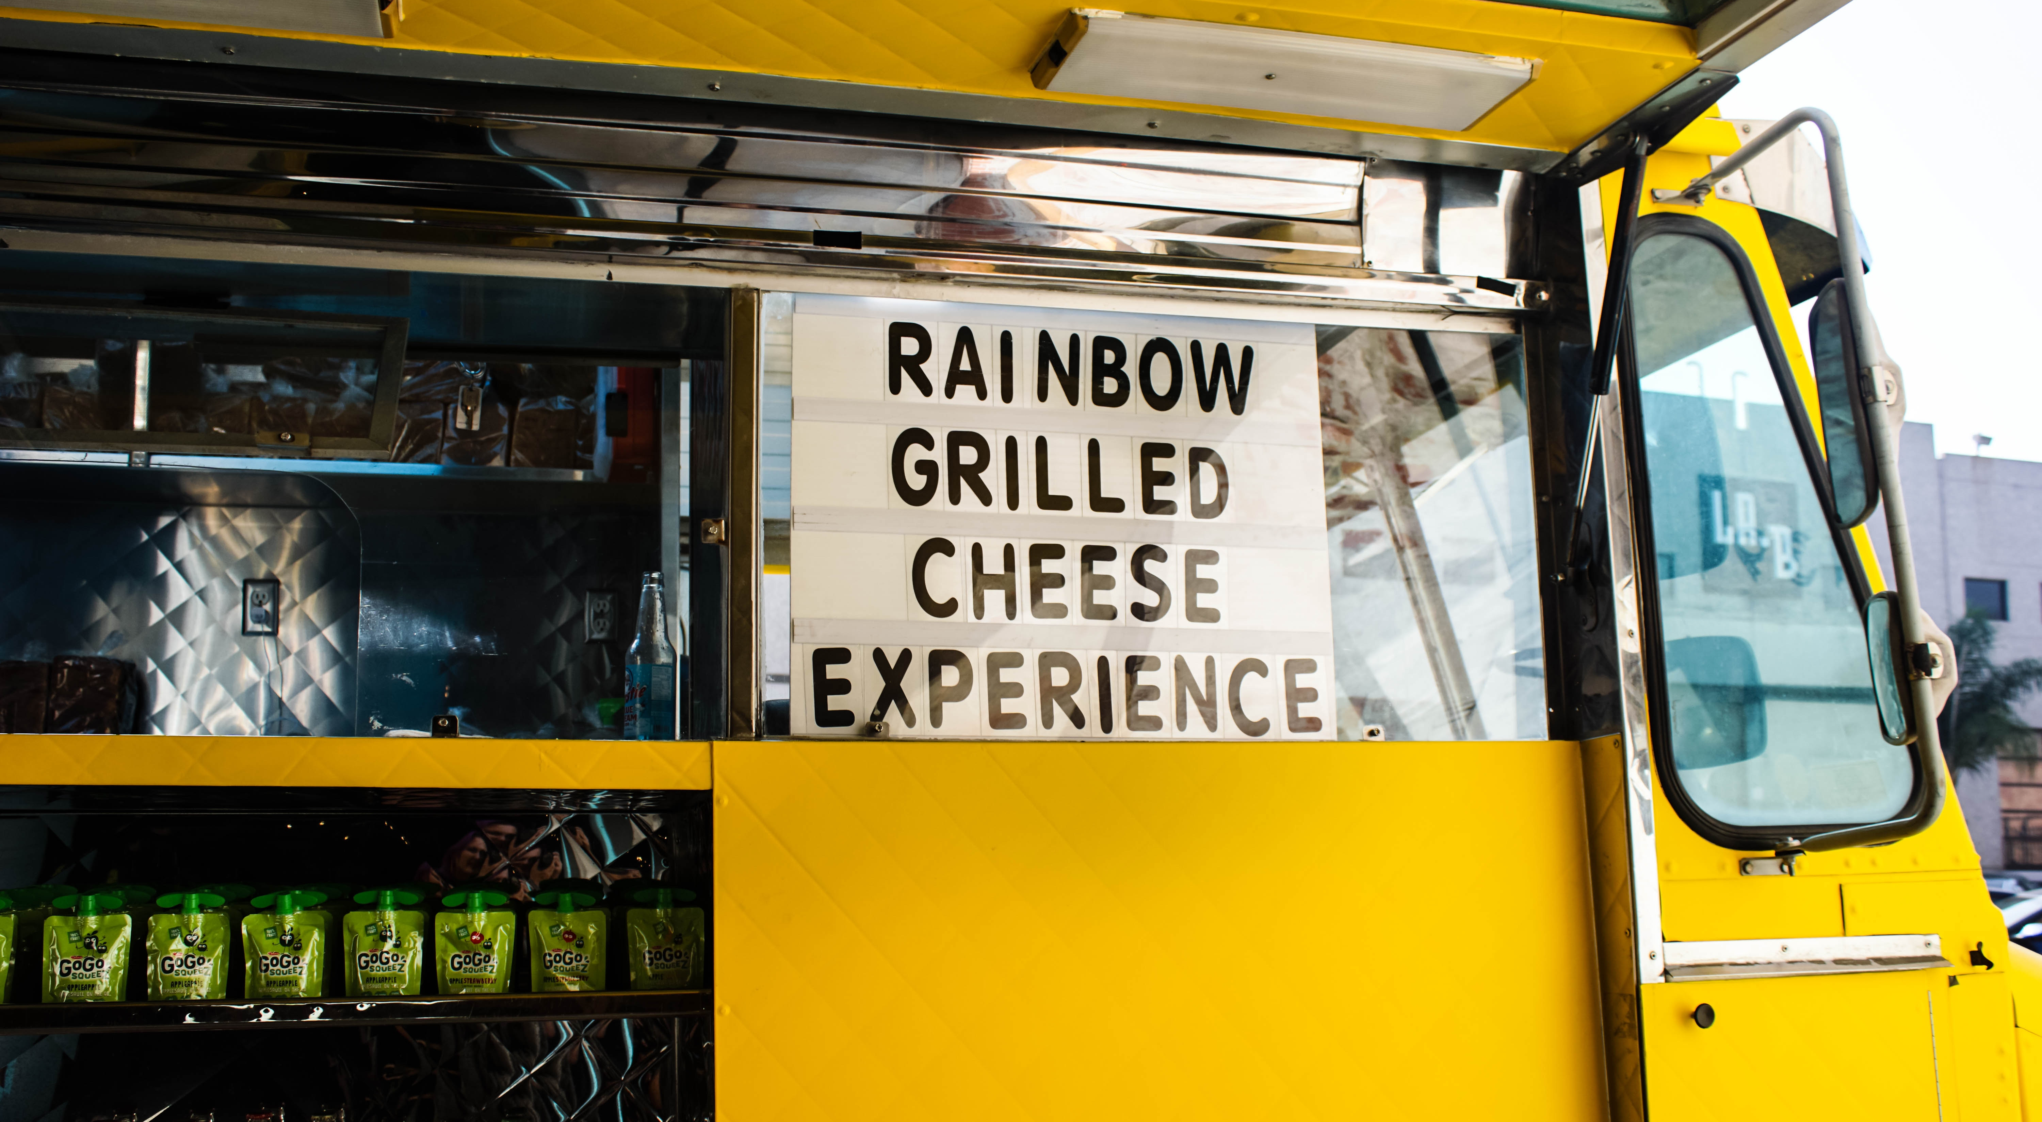
the future…

